Slide 1
Paediatrics
Genito urinary disorders

Slide 2
Conditions
GUT disorders; UTIs, vescoureteral reflux
Glomerular disease
Acute glomerulonephritis
Chronic/ progressive glomerulonephritis
Nephrotic syndrome
Renal failure
Congenital abnormalities
polycystic Kidneys
Undescended Testes
Ambiguous Genitalia
Hypospadias/epispadias
Phimosis/paraphimosis
Hydrocele

Slide 3
Variations in pediatric Anatomy and physiology of GUT
Urinary and reproductive organs are present at birth and their functions are immature
Structural differences –
The kidney is large compared to the abdomen size until adolescence. Due to the size, the kidney of a child are less protected from injury by ribs and fat padding compared to adult
The urethra is shorter in females putting them at higher risk of bacterial infection of the bladder. The female urethral opening and rectum are in close proximity in infants and child. The male urethra is shorter in children thus high risk of UTIs
Urinary concentration – blood flow through the kidney is slower in children than in adults and kidneys are less able to concentrate urine putting them at higher risk of dehydration when there is fluid loss.
Renal system reaches functional maturity at 2 yrs
Urine output – bladder capacity is about 30ml in newborns, increases to adult capacity – 270ml at 1yr. urine output in infant or child – 0.5-2ml/kg/hr. 1yr – 400-500ml/day, adult 800-1500ml/day(3-8times a day).
Reproductive organ maturity – are immature at birth. gonads mature at adolescence

Slide 4
Common signs and symptoms of urinary tract disorders in children
Poor feeding, vomiting, failure to gain weight
Frequent urination, screaming on urination, poor urinary stream, foul smelling urine, blood in urine, dehydration, excessive thirst, enlarged kidneys, frequent urination
Persistent diaper rash, pallor, fever, seizures, abdominal/back pain, HTN, edema

Slide 5
Nursing process overview for the child with a genitourinary disorder
Assessment
Health history – history of present illness, family history, PMHX, birth history. On HPI, inquire on:
Burning sensation when passing urine, changes in voiding patterns, foul urine, vaginal or urethral discharge, genital pain or discomfort, blood in urine, edema, mass in groin, scrotum or abdomen, flank or abdominal pain, cramps, poor growth and weight gain, fever, trauma. TAKE HX OF TOILETING HABITS
Physical examination
Inspection – general appearance, growth retardation and weight gain, edema(general, periorbital), pallor, lethargy, confusion. Inspect external genitalia for rash, constant urine dribble, displaced urethral opening, reddened urethral opening and discharge. Females – vaginal irritation, male – scrotal enlargement and colouration. Abdominal distention
Auscultation – heart sounds- murmur, heart rat, BP with appropriate cuff, auscultate lungs if has edema
Percussion – dullness above pubis symphysis shows full bladder
Palpation – palpable kidneys indicate enlargement or mass, abdominal mass, distended bladder. Palpate scrotum for descended testicles, masses, retractable foreskin

Slide 6
Nursing process cont’
Laboratory and diagnostic testing
Complete blood count – infections
Blood urea nitrogen(BUN) –
Creatinine – diagnose impaired renal function
Electrolytes – K, ca, Phosphorus
Urinalysis – color, ph, glucose, protein, blood cells
Cystoscopy – endoscopic visualization of urethra and bladder
Urine culture and sensitivity
Renal biopsy
Renal ultrasound – visualize kidney, ureters, bladder
Nursing diagnoses and related interventions
Impaired urinary elimination
Fluid volume excess related to decreased urine output – weighing, monitor edema, auscultate lungs for crackles, decrease sodium and water intake, diuretics, input-output
Imbalanced nutrition less than body requirement related to protein loss
Risk of infections
Urine retention related to obstruction
Impaired urinary elimination related to UTI
Knowledge deficit related to lack of information on condition
Activity intolerance related to edema, anemia, weakness
Disturbed body image

Slide 7
UTIs
May affect the entire urinary system
Common forms of UTI include bacteriuria, febrile UTI, persistent UTI, cystitis, urethritis, pyelonephritis
Peak incidence is 2 to 6 yrs, with female affected more
The most common cause is Escherichia coli. The microorganisms are common to the anal, perinal and perineal region
Predisposing factors
Role of anatomic and physical factors in UTIs
Short urethra in female (2 cm young girl, 4cm mature woman)
Uncircumcised infants of < 1 yr have high risk
Urinary stasis due to reflux, deformed ureter and dysfunctional voiding
Catheters esp short term indwelling catheter
Use of antibiotics
Tight clothing, diapers,poor hygiene and local infection
Altered urinary and bladder chemistry
In adequate fluid intake and dehydration predisposes to UTI. Urination flashes out infection

Slide 8
Signs and symptoms
In children < 2yr symptoms resemble GIT disorders e.g FTT, feeding problems, vomiting diarrhoea, jaundice etc. other suggestive symptoms are change in frequency of voiding, strong smelling urine, abnormal stream
In >2ys, symptoms include enuresis or day time incontinence, fever, strong foul smelling urine, urgency, increased frequency, dysuria, flank pain or abdominal pain
Signs of pyelonephritis include high fever and chills accompanied by flank pain, severe abdominal pain and leukocytosis
Dribbling of urine, straining on urination or reduced force and size of the stream may indicate obstructive uropathy
Adolescents show more specific symptoms such as frequent painful urination

Slide 9
Diagnosis
Appearance; cloudy,hazy or thick with noticeable strands of mucus or pus, smells fishy and unpleasant
Microscopy; gram staining
Urine culture of collected urine
Collect in the morning from supra pubic aspiration (<2yrs) and from bladder catheterization
Management
Aims at: Eliminating organism, reducing contributing factors, prevent urosepsis and preserve renal function
Antibiotics; penicillins, nitrofurantoin, cephalosporins
Correct assessment through history and specimen collection
Adequate fluid intake 100ml/kg
Avoid caffeinated or carbonated drinks because it irritate bladder

Slide 10
Glomerulonephritis
Glomerulonephritis is a post infectious inﬂammation of the glomerular capillaries: Acute and chronic glomerulonephritis
Acute glomerulonephritis
Common in children older than 2 years of age, with age peak of 6 to 7 yrs
Its an acute inflammatory disease commonly occurring after a streptococcal infection of the skin and the throat.

Slide 11
AGN
Infection with a beta A haemolytic streptococcal bacteria may initiate glomerulonephritis after 10 to 14 days. Other predisposing factors include impetigo(skin infection) , acute viral infections URT, mumps, varicella zoster virus, Epstein Bar virus,hepatitis B virus, HIV etc
Once the body gets infection, the bacteria releases a membrane like material into bloodstream which act as an antigen. The body produces antibodies that react against the antigen, forming an antigen-antibody complex.

Slide 12
AGN
The complex is deposited in glomerulus initiating an inflammatory response characterized by increased production of epithelial cells lining glomerulus, leukocyte infiltration and thickening of glomerular filtration membrane. This membrane forms scars hence decreasing GFR.
SUMMARY;
Its characterized by;
Deposition of antibody-antigen complex into glomerulus
Initiation of inflammatory response
Thickening and scarring of glomerular membrane and narrowing of afferent vessel
REDUCED GFR which leads to excessive accumulation of water and sodium

Slide 13
Clinical manifestation
Early signs are periorbital edema (puffiness of the face around the eyes) especially in the morning, anorexia and passage of tea coloured or cola cloured urine in small amounts (hematuria)
Oedema is moderate spread to extremities and abdomen during the day
Reduced urine output associated with raised BUN and serum creatinine
The child is pale, irritable and lethargic. Older children may complain of headaches, dysuria and abdominal pain
Blood pressure is usually moderately elevated except in acute phase
The child may have seizures caused by hypertensive encephalopathy, pulmonary and circulatory congestion
Mild to moderate proteinuria (<3g/day) is present
Primarily they are moderate hematuria, eodema, Oliguria, azotemia(high nitrogenous wastes and urea) proteinuria ( mild to moderate)
Prognosis; most children recover completely

Slide 14
Investigations
Urinalysis –RBC,WBC, granular and hyaline casts,mild to moderate proteinuria
On culture no bacteria
Blood
High blood urea nitrogen and creatinine (azotemia)
Normal electrolytes
Throat and skin swab for culture for streptococci
Physical examination and chest x ray; enlarged kidneys, edema, congested lungs
Reduced serum complement level 3 (C3) in the first week

Slide 15
Management
Pharmacological; depends on the cause,
Streptococcocal infection-penicillin . They don’t alter the course of the disease but prevents transmission of nephritogenic streptococci to other members
Other drugs include corticosteroids, diuretics
Dietary –
Sodium restriction incase of edema and HTN. Do not add salt on the table
Protein restriction if azotemia is present
Potassium during oliguria
Fluid balance
Monitor input output
Measure weight daily
Restriction of IVFs if out put is < than 2-3dl/24hr
HTN
Measure BP after every 4 hrs.
Administer loop diuretics e.g calcium channel blockers, ACE inhibitors
Patient education-disease, investigations, homecare(diet, BP monitoring, signs of renal failure etc)

Slide 16
Complications
Hypertensive encephalopathy
Heart failure
Pulmonary edema
Acute Renal failure

Slide 17
Chronic glomerulonephritis
Predisposing factors include;
Repeated episodes of-acute glomerulonephritis, hypertensive nephrosclerosis ( hardened renal vessels), hyperlipidemia, glomerulosclelerosis, tubulointerstitial injury
Systemic conditions- lupus erythromatosus, goodpastures syndrome, diabetic glomerulosclelerosis, amylodosis
The above diseases either attacks the kidneys directly or form immune complexes that initiates chronic destruction of kidneys
More common in adolescents
Nephrotic syndrome often develops
It manifest by HTN, edema, proteinuria, cardiac failure, dyspnoea, osteodystrophy and anemia
Lab may show proteinuria, high BUN, creatinine, high potassium and phosphorus but reduced calcium levels. Others include metabolic acidosis

Slide 18
Nephrotic syndrome
It is a clinical syndrome characterised by ;
Marked proteinuria
Hypoalbuminemia
Edema (anasarca)
Hyperlipidemia ( cholesterol and LDL)
The most common presentation of glomerular injury in children
It is a manifestation of glomerular diseases that cause increased glomerular permeability to plasma proteins

Slide 19
Causes
75% cause is unknown
Glomerulonephritis esp. membranous type
Metabolic diseases- DM
Collagenous vascular diseases-SLE, periarteritis nodosa
Circulatory disease-HF, SCD, renal vein thombosis
Nephrotoxins mercury gold
Infections TB, enteritis
Allergic reactions
Heredity nephritis
Neoplastic diseases- multiple myeloma
Septicaemia

Slide 20
Pathophysiology
Damage occurs to glomerular capillary membrane, increasing its permeability to plasma proteins- majorly albumin.
Proteins are lost through urine(proteinuria). Loss of albumin leads to hypoalbuminemia.
Hypoalbuminemia results in decreased oncotic pressure hence fluid shift from vascular compartment into interstitial space(hypovolemia and generalized edema)
Hypovolemia stimulates activation of renin angiotensin system, causing sodium retention with resultant edema.
Loss of plasma proteins also stimulates synthesis of lipoproteins leading to hyperlipidemia

Slide 21
Clinical manifestations
Oedema which results because of salt and water retention
Soft pitting
Commonly occurs around eyes(periorbital) which worse in the morning, independent areas (sacrum,ankles, and hands) and in the abdomen (ascites), swollen genitalia (labia/scrotum)
NB;
The child begins to gain weight insidiously/slowly and parents may think the child is becoming healthy
Edema in the intestines may cause diarrhoea and loss of appetite
The volume of urine reduces, appears dark and frothy
The child’s skin has tendency of break down coz of edema, he is suscptible tp pneumonia,cellulitis, sepsis, peritonitis
Proteinuria predominantly albumin >3.5g/day (hallmark of nephrotic syndrome). Urine may appear dark

Slide 22
Diagnosis –
Urinalysis- protenuria> 3.5g/day, high WBC, granular and epithelial casts
Protein eletrophoresis- identify specific protein
Needle biopsy of the kidney
Serum markers- to diagnose lupus
Blood tests- low albumin, high cholesterol, phospholipids and triglycerides

Slide 23
Management
Goal – preserve renal function and prevent complications
Drugs –
Loop diuretics and angiotensin converting enzyme inhibitors treat edema (lasix plus metalozone)
Corticosteroids such as prednisone given till urine is free from protein and remains normal for 10 days to 2 weeks to prevent relapse of infection. Approx (3months)
Immunosuppressants such as azathioprine, chloambucil, cyclophosphamide are recommended if relapse occurs after prednisone. Monitor WBC
Plasma expanders may be used salt-poor human albumin for severe edema

Slide 24
Management
Nutrition –
Meals high in protein and carbohydrate, low salt and fat.
Restrict fluid intake, maintain fluid chart,
Daily weight to monitor weight gain
Protein monitoring,
Proper hygiene
If no hyperkalemia include leberal potassium to enhance Na+/K+ pump

Slide 25
Nursing management
Nurse patient in Fowlers position
Administer medication, assess patient’s response and adverse reaction
Monitor diet
Check patient’s urine protein- frothy appearance
Skin care- to combat edema and pressure areas; pressure reducing mattress, turning and moving.
Encourage activity and exercises, provide anti embolism stockings
Monitor input/output, weight, vital signs, abdominal girth, edema. TPR and BP monitoring 4hrly
Family reassurance and support especially during acute phase
Assist with diagnostic procedures

Slide 26
Complications
Infection due to low immunity
Thromboembolism
Pulmonary emboli
ARF due to hypovolemia
Accelerated atherosclerosis due to hyperlipidemia

Slide 27
Renal Failure
Is the inability of the kidneys to excrete waste materials, concentrate urine and conserve electrolytes
Can be acute or chronic
Causes – reduced flow in kidney due to shock, MI, obstruction of urinary tract, medications – nephrotoxic, Glomerulonephritis,
Symptoms
Hemorrhage, fever, vomiting, abdominal pain, low or high urine output, edema i/o
Pale
Rx – IV fluids if due to shock, diuretics, electrolyte monitoring, BP. Chronic RF – diuretics, dialysis, kidney transplant, medication, anemia Mx, diet – restrict protein. Fluid and electrolyte balance

Slide 28
Acute renal failure
Occurs when the kidneys suddenly becomes unable to regulate the composition of urine as per intake
It is not common in children
Causes
Pre renal causes; Reduce renal blood flow.
They are the most common causes; they include, Hypovolaemia (most common) , Drugs (NSAID),Decreased cardiac output, Decreased vascular resistance,Vasodilatation (sepsis)and sepsis, renal artery obstruction, for example aneurysm and bilateral renal artery occlusion.
Direct renal damage to the renal tissue (parenchyma) or changes that result in the malfunction of the nephrons. Examples include: Nephrotoxic substances, Acute tubular necrosis, Glomerulonephritis, Acute pyelonephritis, Trauma
Post renal; Mechanical obstruction of urinary outflow not common

Slide 29
Pathophysiology
Hypovolaemia and decreased renal blood flow stimulate renin release which activates the angiotensin-aldosterone system. This results in constriction of the peripheral arteries and the renal afferent arterioles.
With decreased renal blood flow, there is decreased glomerular capillary pressure and glomerular filtrate rate, tubular dysfunction and oliguria
Ischaemia causes anoxia which leads to endothelial cell oedema. Edema raises tissue pressure which results further depresses the GFR
It also alters glomerular epithelial cells and decreases glomerular capillary permeability.

Slide 30
Clinical signs
Prime manifestation is oliguria which is passage of < 1ml/kg/hr
Others inlcude edema, drowsness, circulation congestion, hyperkalemia, hyponatremia, hypocalcemia and metabolic acidosis
Mnx
Oliguria; adm mannitol or furosemide
Fluid and calories; give food high in carbohydrates and fat but low in protein, potassium and sodium
Accurate intake and output, body weight and electrolyte measurement
To treat hyperkalemia (the most immediate threat to the child’s life in ARF)
IV calcium gluconate 0.5ml/kg over 2 to 4 minutes, protects cardiac function
IV Sodium bicarbonate, 2 to 3 mEq/kg over 30 to 60 minutes; elevate PH thus potassium moves into intracellular fluid
IV Glucose 50%, and insulin 1unit/kg to accelerate glycogen synthesis causing potassium to move into cells
Dialysis removes potasium
HTN
Monitor HTN 4hrly, use drugs such labetalol, hydralazine

Slide 31
Chronic renal failure
The kidney is unable to maintain its function till 50% of functional renal capacity is destroyed
Begins when kidney cant maintain its functions in normal conditions, progresses slowly till uremia and eventually ESRD develops
The commonest cause of CRF in under five is congenital renal and urinary tract malformations (renal hypoplasia and obstructive uropathy) and vesicoureteral reflux
For children 5 to 15 yrs, glomerular hereditary disease predominate majorly chronic pyelonephritis,CGN, lupu erythromatosus, alport syndrome,polycystic kidney

Slide 32
Common abnormalities of CRF
Retention of waste products; esp creatinine
Water and sodium retention due reduced GFR leading to edema and vascular congestion
Hyperkalemia esp in ESRD
Metabolic acidosis
Reduced calcium and phosphorus leading to renal osteodystrophy, bone pain (bone demineralization) due to dissolution of alkaline salts to neutralize acidosis, reduced GFR which reduces excretion of phosphorus (elevated serum phosphate with reduced serum calcium), low calcium stimulate release of parathyroid hormone that increases reabsorption of calcium from bone, reduced synthesis of vit D
Anemia due to short life span of RBC, impaired RBC production related to low erythropoietin, blood loss related to increased risk of bleeding, hyperparathyroidism, hypersplenism etc
Growth failure due to HTN, Mineral/vitamin deficiency, dietary restriction, poor appetite, renal osteodystrophy, tissue resistance to growth hormone, corticosteroid treatment etc
Children are more susceptible to infection; pneumonia, UTI, septicamia
Dental abnormalities; hypoplasis, disclolouration,malocclusion

Slide 33
Clinically
Initially, the child has increased fatigue on exertion hence reduced play, may be pale, has reduced growth and elevation of BP
Later signs include
Skin may develop a characteristic sallow muddy appearance due to anemia and deposition of urochrome
Headache, muscle cramps, nausea, weight loss, facial puffiness, growth retardation, bone/joint pain, dryness or itching skin
Amenorrhea in adolescent girls
Loss of appetite, nausea and vomiting
Bleeding tenderness in bruises, bloody diarrhoea, bleeding from stomatitis, gums and lips
Deposits of urea crystals on the skin (uremic frost), uremic breath
Metabolic acidosis manifested by deep breathing
Neurologic; confusion, coma, tremors, twitching seizures

Slide 34
Management
Allow unrestricted activity, let them set their own limit of rest
Dietary mnx
Restrict phosphorus
Increase protein and carbohydrates
Restrict sodium and water only if there is edema or HTN
Restrict potassium only if creatinine clearance is below 30 to 35ml/min, with oliguria or anuria
Osteodystrophy; reduce dietary phosphorus (reduce protein and milk), adm phosphorus binding agent, provide calcium supplements, adm vitamin D
Acidosis; reduce protein, adm alkalizing agents such as sodium bicarbonate
Anemia; provide folic acid and iron. Hematinics are not usually effective. May also give recombinant human erythropoietin
HTN; low sodium diet, fluid restriction, diuretics (thiazides and furosemide) if severe give beta blocker and vasodilator
Growth failure; recombinant human growth factor, nutrition as per RDA

Slide 35
Phimosis and paraphimosis
Phimosis - foreskin of the penis in narrow and cannot be retracted over glans
Its normal in infants and young boys but disappears with growth
It may obstruct urine flow leading to ballooning or even dribbling during voiding
Fore skin may be infected (balanitis) which if severe surgery or circumcision may be required
Paraphimosis – tight prepuce causes a constricting band behind the glans of the penis and obstructs the organ and blood supply.
It’s a urologic emergency
Managed by circumcision. Characterized by pain, swollen penis, dysuria, irritation or bleeding

Slide 36
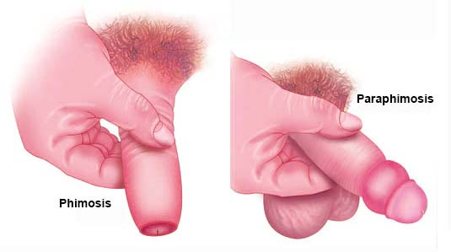
Phimosis and paraphimosis diagram

Slide 37
Cryptorchidism
Cryptorchidism (undescended testicles) - One or both testicles do not descend normally through inguinal canal into the scrotal sac.
It is common in preterm babies
Anorchism is when there is no testes
Its always accompanied by congenital hernias the testes is at risk of subsequent torsion
Complications are sterility and testicular cancer. Managed by surgery

Slide 38
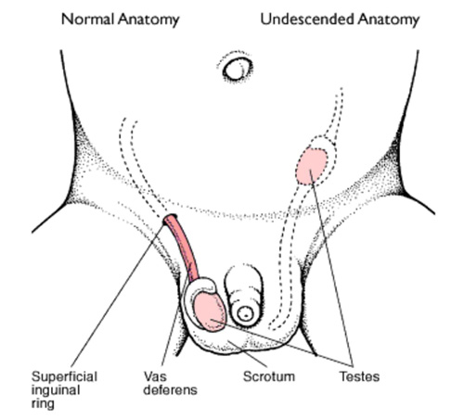
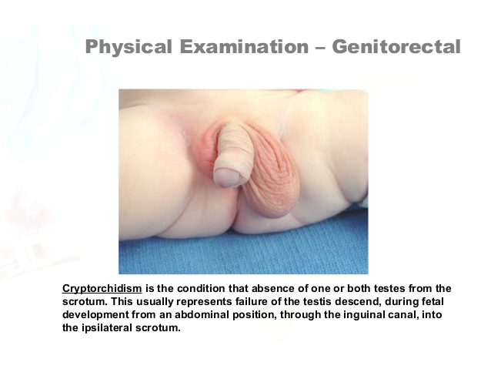
Cryptorchidism

Slide 39
Hydrocele and varicocele
Hydrocele is the presence of fluid in the scrotal sac (processus vaginalis)
Un like hernia, It may not be reducible and intraabdominal pressure does not produce it
Resolves spontaneously by 1 yr of age.
Varicocele – a venous varicosity along the spermatic cord – swelling in the scrotal sac.
Complicates to infertility. Presents as enlarged scrotum, decreases when lying, mass in scrotum, veins feel worm-like on palpation and some pain.

Slide 40
Others
Hypospadias; urethral opening is located below the glans penis or anywhere along the ventral (under) surface of the penile shaft,. Its accompanied by chordee(ventral curvature of the penis) with absence of fore skin ventrally giving the penis a hooded and crooked like appearance
Epispadia; opening of the urethra on the dorsum of the penis
Bladder exstrophy; is the externalization of the bladder with no tubular formation and separation of the pelvic bone
Polycystic kidney disease
Fluid filled sacs that cause kidney to enlarge. Are genetic. Rx – Mx of symptoms, HBP, UTI, ESRD – dialysis and transplant

Slide 41
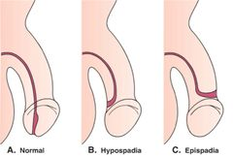

Slide 42
